Slide 1




WELCOME to GDD 450
Your New Job
Brent M. Dingle, Ph.D. 2015
Game Design and Development Program
Mathematics, Statistics and Computer Science
University of Wisconsin - Stout

Slide 2
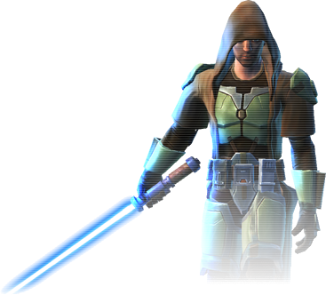

Instructor / Manager / Producer
Brent Dingle, Ph.D.
  Office: JHSW, Room 219
  Office Hours:
    Tues/Thurs 2:00 - 3:30
    Wednesday 1:30 - 2:30
  Office Phone: N/A
  Email: dingleb@uwstout.edu
Course Info: Check online D2L
Syllabus is also online

Slide 3
Sidetrack
Details to Follow
But First A Brand New Game

Slide 4
Brand New Game
Here’s a game I did not create
  and it really isn’t brand new
  but it might be new to you
    if it is not… let those who have not seen it enjoy it
2 player game
Goal:
  Collect a set of three numbers that add to 15

Slide 5
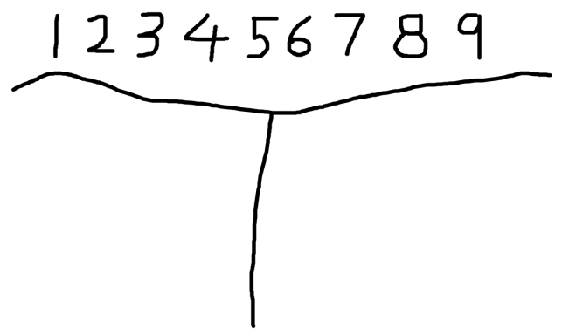
Rules
Setup
  Write the numbers 1 through 9 at the top of a sheet of paper
  Below that draw a line to divide the paper into 2 halves
    one half for each player
  Choose a player to go first
Play Progression
  on your turn
    choose a number that has not yet been used
    cross it off the list of numbers at the top
    write it on your ‘half’ of the paper (to show it is yours)
Resolution
  if either player acquires a set of three numbers that add to 15
  then that player wins
  if all the numbers are used and neither player has such a set of three
  then the game is a draw

Slide 6
Moving On
Try NOT to play that while we continue

Slide 7


In Case of Emergency
Locate the exit door
Note the exit paths
If the door cannot be located
  it’s too late

Slide 8

Welcome
Welcome to Your New Job in
3D Game Design and Development!
Let’s begin with an overview of what this job entails…

Slide 9
Company Vision Statement
To achieve greatness
and affect the world in a positive way
through
dedication, commitment,
and creative construction
of meaningful games

Slide 10

Employee Benefits
  Experience in Game Design and Development
    Pitching, Prototyping, and Planning
    Implementing
  Experience working as a Team
  Exercise Presentation Skills
  Become familiar with approaching design and development from a System Level Perspective
  plus much, much, more!

Slide 11
The Subtle Benefits
This “job” is about more than just making a game
  You have an opportunity
    learn to work as a member of a team in a professional manner
You should practice and improve many of your ‘soft’ skills
  Engaging, interacting, and communicating with others
  Evaluating your own work
    Estimating time to completion
    Professionally responding to criticism
  Evaluating the work of others
    Giving useful/constructive feedback to others
  Managing workload (meeting deadlines)
    Responding to dynamic change
    Being accountable for what you say you will do (and when)
  and more…

Slide 12

Retirement Plan
None Available
  HR is working hard to find more options

Slide 13

Work Ethic
Take responsibility
  for what you do
  and for what you do not do
Trust and Believe in yourself
  so your teammates can too
Never Lie, Never Cheat, Never Steal
  Elaboration, Collaboration, and Borrowing
    are usually acceptable

Slide 14
Vacation Days
None
  So don’t get sick =)
Missing class will result in a reduction of your evaluation score
  Special consideration can be given
  In the event you know you will be gone
    Consult with management BEFORE being absent

Slide 15

Tools
This lab
  Plus
    Whatever else a team agrees to use and has access to
  Pick tools appropriate for what
  you need to accomplish
    and allow the task to complete ontime

Slide 16
Your Job Description
Work on small independent assignments
  very few in number
Work on and Complete
game design and development project(s)

Slide 17
Pay Scale
You work for free
    you volunteered didn’t you?

Slide 18
Work Evaluation
You will be evaluated by
  Yourself
  Your Instructors
  Your Peers

Slide 19
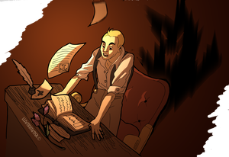
Assignments
Most of your time will be on a Team Project
  Designing and Developing a Game
In the background
  Individual work also required
    Personal Webpage, Portfolio, Resume…

Slide 20

Project General Setup
Your choice of ‘engine’
  Unity
  Unreal
  In-House Designed
  Other
Team must agree in majority vote
  Instructors will break any tie

Slide 21
Notice on Engines and Software
You have been hired because you ALREADY have skills
You are expected to USE AND GROW YOUR SKILLS
  This includes learning how to best select and use tools to produce the specific product you are working to achieve
Focus of class is not teaching tool use
  You are a senior → trained in theory and practice
  Learning a tool is applying what you know
    That’s the easy part
  The hard parts are more about
    how to make (good) choices
    how to quickly (and correctly) adapt and overcome difficulties
    how to communicate
    how to manage stress, deadlines, working with others, time…
    determining how and what actually must be done (and not done)

Slide 22
General Work and Project Info
3D environment
Dynamic Team Structure
  Teams of about 6 people each
  Members will be selected by the instructors
Games will be selected from student presented pitches
  By the instructors and assigned to teams

Slide 23
What Does 3D Mean?
Make a 3D game
Does it have to be “pure 3D”
  Not necessarily
  Be Creative
  It should require and use 3D models
  It should have objects moving in 3D space

Slide 24
Who’s in Charge
Course Instructor(s) have
  Final say on everything
  Control of process
Student Teams
  Design and Develop the game
  Start with Dynamic Leadership
    If you cannot get along or you function incorrectly
      Your grade drops

Slide 25
Organizational Chart
GDD Instructors
Team 1
Team 2
Team 3
Team 4
Students

Slide 26
General Work Schedule/Deadlines
Project work will be divided into Sprints
  Sprints are 2 to 3 weeks in duration
BUT
Every Sunday Night
  Have a working build
Test everything BEFORE committing

Slide 27
Near Future: Tentative Schedule
Sep 9 | This Presentation
Sep 11 | Self Presentations and Resume
Sep 14 | Pitch Presentations and Inception Docs
 | Prototype Teams Identified
 | Top 6 to 12 presentations are identified Each of you is placed in a team of 2 to 4 people Each team is given a game from the set of top pitches. The team creates a mockup and prototype and a presentation, plus evaluations on each other.
Sep 21 | Prototype – Video of Mockup
 | Turn in video of mockup of prototype game (no presentations yet)

Slide 28
Main Project: Tentative Schedule
Sep 30 | Prototype (this is a Wednesday oddity)
 | Presentations, plus. Also : Main Teams should be announced.
Oct 2 | Quiz 1 - Bring loose leaf paper and a pencil
Oct 5 | S1 Team Rules (part of Sprint 1, but due early)
Oct 12 | S1 Mockup due (and video of)
 | May be asked to demo to instructor(s) in class
Oct 19 | S1 Design Doc due (includes art choices and selections, game mechanics…)
Oct 26 | Sprint 1 Ends
 | In-Class Presentation plus stuff
 | Peer Evals

Slide 29
Main Project: Tentative Schedule
Nov 16 | Sprint 2 Ends
 | Presentation, Game Demo (with mp4 video), Sounds, Evals, plus
Nov 23 | Game Testing/Demos
Nov 25 | 11/25 to 11/29 Thanksgiving
Dec 7 | Sprint 3 Ends
 | Presentation, Game Demo (with mp4 video), Posters, Evals, plus
Dec 14 | Last class day (notice this is a Monday)
 | Think: BETA release version of game, plus anything else not already turned in…
 | Check University Calendar for Final Exam Date

Slide 30
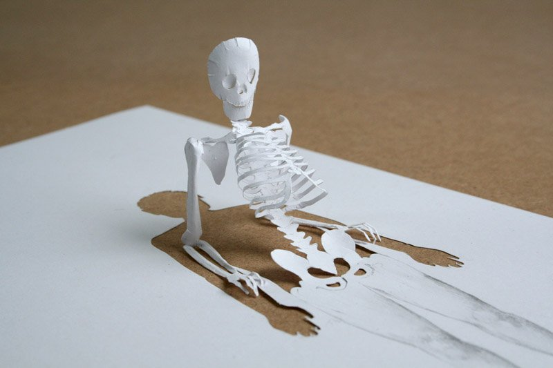
Project Action Points
You will be assigned a team
  Learn the names of your teammates
  Set up reliable communication channels
    Have contact information memorized
  Understand that you may be held accountable for the actions of a teammate
    Learn to moderate and help each other
Peter Callesen
http://www.taringa.net/posts/imagenes/15821765/Arte-en-papel-Inusual.html

Slide 31
Project: Additional Think-Abouts
Be Creative and Different
  This can get you into conferences
  and win competitions
Code Repository
  Team must choose how to keep files organized and where
    including naming conventions

Slide 32
Note on Grading
To encourage Active Participation in Teams
You will have 2 grades
  Team(s) Grade
    The general/overall grade for the team product(s)
  Individual Grade
    The individual’s contribution/effort/… to make the team product(s)
    Includes peer evaluations
    Also receives a small bump upwards from the individual based assignments (pitches, papers…)
ASIDE: It is unlikely but possible for every individual to score below the team’s product grade…
it’s called a ‘lucky’ turn of circumstances/outcome of product.
The opposite is also possible and is called ‘unlucky’ – commonly caused by a bad presentation

Slide 33
Note on Grading
At the end of the semester
  if Individual Grade < Team Grade
    then Final Grade = Individual Grade
  if Individual Grade >= Team Grade
    then Final Grade = average of (Individual and Team)
Worked below the average of your team
Worked above the average of your team
In sum
You want to over-achieve your teammates
and they likewise…
thus everybody works (tries hard)
and individuals do better AND team does better

Slide 34
End Summary
This will be the BEST JOB EVER!!
Make friends with ALL your classmates/coworkers
Contemplate:
6 | 7 | 2
1 | 5 | 9
8 | 3 | 4

Slide 35
Questions?
Beyond D2L
  Examples and information
  can be found online at:
    http://docdingle.com/teaching/gdd450/
    Continue to more stuff as needed

