Slide 1
What is a Game?
GDD 450
Brent M. Dingle, Ph.D. 2015
Game Design and Development Program
Mathematics, Statistics and Computer Science
University of Wisconsin - Stout
See also references at end of slides (if any)

Slide 2
By Now
You are Seniors
You know the answer to this right?
Any suggestions?
What is a Game?
Write some of your thoughts down

Slide 3
A Definition
A Game is
a play activity with rules that involves conflict
Problem?
It says nothing about how to design a game

Slide 4
Formal Elements
Perhaps easier to discuss a game in terms of its component parts
rules
resources
actions
story
…
These may also be called “formal elements” of a game

Slide 5
Distinguishing Between Games
Consider the game
Three to Fifteen
Heard of it?
It was described in the introduction to this class

Slide 6
3 to 15
2 player game
Goal:
Collect a set of three numbers that add to 15

Slide 7
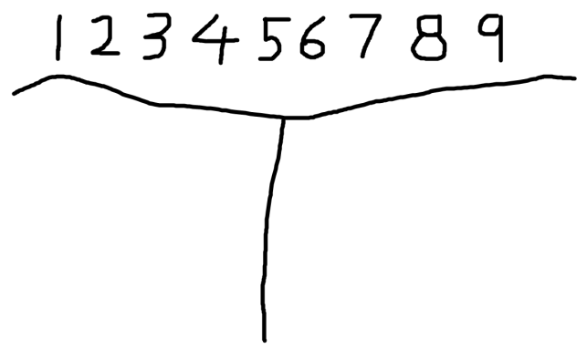
Rules
Setup
Write the numbers 1 through 9 at the top of a sheet of paper
Below that draw a line to divide the paper into 2 halves
one half for each player
Choose a player to go first
Play Progression
on your turn
choose a number that has not yet been used
cross it off the list of numbers at the top
write it on your ‘half’ of the paper (to show it is yours)
Resolution
if either player acquires a set of three numbers that add to 15 then that player wins
if all the numbers are used and neither player has such a set of three then the game is a draw

Slide 8
Consider
Introduce this table to the game
And what does the game become?
6 | 7 | 2
1 | 5 | 9
8 | 3 | 4

Slide 9
Same or Different?
Same game?
Different games?
Answer?
depends on what the question really means.
6 | 7 | 2
1 | 5 | 9
8 | 3 | 4

Slide 10
Common Vocabulary
To talk about something
Helps if all the people talking
agree to what certain words mean
Allows us to talk about games and analyze games in a critical fashion
examine and discuss the parts of a game
how they fit together
both good and bad

Slide 11
Common Game Presentation
Compare the “new” game idea to what already exists
Grand Theft meets WOW
May be a good description
Unless the audience is not familiar with one or more of the existing games

Slide 12
Define New Words: More Jargon?
Could define new words
But already have words
Let’s try to find a way to use them clearly
recognize what they might mean
and work with that
Examples may also help

Slide 13
Definition 1
A game has “ends and means”
an objective,
an outcome,
and a set of rules to get there
David Parlett

Slide 14
Definition 2
A game is
an activity involving
player decisions,
seeking objectives
within a “limiting context”
Clark C. Abt

Slide 15
Definition 3
A game has six properties
it is “free”
playing is optional and not obligatory
separate
fixed in space and time, in advance
has an uncertain outcome
is unproductive
generates neither goods nor wealth
is governed by rules
is “make believe”
not real life, but a shared separate reality
Roger Callois

Slide 16
Definition 4
A game is a
voluntary effort to overcome unnecessary obstacles
Bernard Suits
NOTE: this definition implies
voluntary
with goals
and rules
“unnecessary”
implying inefficiency caused by rules on purpose

Slide 17
Definition 5
Games have 4 properties
Closed formal system
formal meaning defined
Involve interaction
Involve conflict
Offer safety
as compared to what they might fully represent
Chris Crawford

Slide 18
Definition 6
Games are a form of art
which the participants (players)
make decisions
to manage resources
using game tokens
in the pursuit of a goal
Greg Costikyan

Slide 19
Definition 7
Games are a system in which
players engage in
an artificial conflict
defined by rules
that results in a quantifiable outcome
i.e. there is winning and losing
book: Rules of Play by Katie Salen and Eric Zimmerman
which also lists all the above definitions

Slide 20
Common Elements?
Games (implicitly) have players
Games are an activity
Games have rules
Games have conflict
Games have goals
Games involve decision making
Games are artificial, safe, outside ordinary life
Games involve no material gain on the part of the players
Games are voluntary
Games have an uncertain outcome
Games are a representation or simulation of something real but are themselves make believe
Games are inefficient
Games have systems
Games are a form of art

Slide 21
Which is Right?
None and All

Slide 22
Slippery Area
Puzzles
crosswords, Sudoko, Rubik’s Cube
Salen and Zimmermann = subset of games
Costikyan = not games, but may be contained in a game

Slide 23
Slippery Area
RPGs
Dungeons & Dragons
Often not considered games
No final outcome or resolution
No winning or losing

Slide 24
Slippery Area
Choose-Your-Own-Adventure BOOKS
Generally not considered games
Reading a book, not playing a game
But add a tear-out character sheet, some stats, skill checks in the book
have now an adventure module

Slide 25
Slippery Area
Stories
Stories are linear
Games much more dynamic
BUT
most games have a story or narrative
Must be related somehow

Slide 26
End Summary
Think about what you mean by “game”
Know those you speak to might not agree
May be best to find a different word
or perhaps an element
to speak about in discussion
Use words to make things clear
Not vague
Avoid misunderstanding

Slide 27
Questions?
Beyond D2L
Examples and information can be found online at:
http://docdingle.com/teaching/gdd450/
Continue to more stuff as needed

Slide 28
References
Some material in these slides was derived/based on material from:
Ian Schreiber, Game Design Concepts
https://gamedesignconcepts.wordpress.com/
Released under a Creative Commons Attribution 3.0 U.S. License
http://creativecommons.org/licenses/by/3.0/us/

