Slide 1
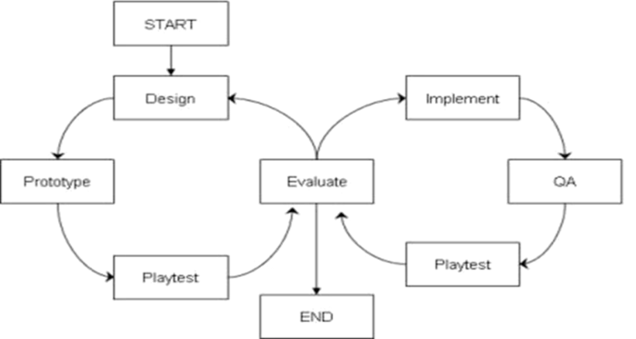
Creating a Game
Iterative Planning and Production
Rapid Prototyping and Mockups
Brent M. Dingle, Ph.D. 2015
Game Design and Development Program
Mathematics, Statistics and Computer Science
University of Wisconsin - Stout
See also references at end of slides (if any)

Slide 2
You Are More
You are more than
an artist
a programmer
You are studying to be
a Game Designer and Developer (GDDer)
What does that mean?

Slide 3
A GDDer Understands
All aspects of design and development
art
sound
programming
story presentation
workflow
management
advertising
communication
…

Slide 4
A GDDer Is
an artist
a programmer
Pretty clear on these two

Slide 5
A GDDer Is
an artist
a programmer
an architect
Architects create blueprints
Games require
Design Docs
Prototypes
From blueprints
consistent (mass) production

Slide 6
A GDDer Is
an artist
a programmer
an architect
a party host
Players are invited into the designer’s “worlds”
for enjoyment and entertainment

Slide 7
A GDDer Is
an artist
a programmer
an architect
a party host
godlike
Creating worlds
And the physical rules that govern those worlds

Slide 8
A GDDer Is
an artist
a programmer
an architect
a party host
godlike
a lawyer
Create
and interpret
and explain
and defend/enforce
rules that players must follow
and co-designers and developers must understand

Slide 9
A GDDer Is
an artist
a programmer
an architect
a party host
godlike
a lawyer
an educator
Many games require
presenting and teaching
new skills, ideas, concepts, frameworks of thinking
to players
and to co-designers/developers

Slide 10
A GDDer Is
an artist
a programmer
an architect
a party host
godlike
a lawyer
an educator
a research scientist
Creating a game
Uses methods very much like the scientific method
Requires study and understanding of fields beyond ‘gaming, art, cs…’

Slide 11
Methods and Process
Creating a game involves
planning and producing
both should be iterative and cyclic
Why?
Consider some history…

Slide 12
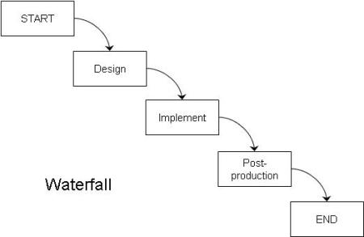
“Old” Process: Waterfall
Design all on paper
Implement/program it
Test it
Add some “bling”
Ship it
Assumes all things go perfect
Moves only in one direction
No way to go back and fix things

Slide 13
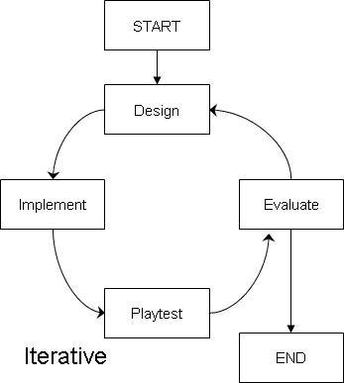
“Newer” Processes are Iterative
Start same as waterfall
Design
Implement
Test
Add an extra phase
Evaluate
Allows making changes if they are determined to be necessary

Slide 14
Link to Scientific Method
Make an observation
Propose hypothesis
Create Experiment to Test Hypothesis
Perform the Experiment
Evaluate Results
Repeat as necessary

Slide 15
More = Better
The more iterations done
The better the game is likely to be

Slide 16
Snag on Video Games
Implementation takes a LONG time
Programming is slow
Debugging is slower
Artwork can be slow
Finalizing is slower
Often difficult and time consuming to change once in place

Slide 17
Solution on Video Games
Rapidly Prototype things
Usually on “paper only” first
Can be “easy digital”
i.e. little to no programming
For clarity
for this class
we often/will call this a mockup

Slide 18
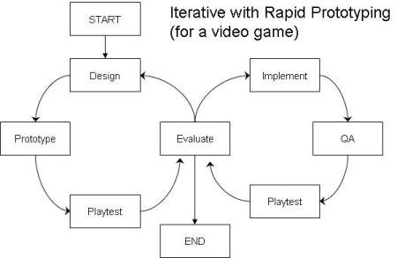
Iterative Rapid Prototyping
More Iterations = Better Game
Iterate as many times as possible
Don’t start implementing until the design/planning is well done
Still possible to go back to design phase after implementation
But minimizes the likelihood

Slide 19
Risks
Games have many risks
Design Risk
Risk game will not be fun and people won’t like it
Implementation Risk
Possibility the development team will not be able to build the game
Market Risk
Game is great, but people don’t buy it
…more

Slide 20
Risks Versus Rapid Prototyping
Games have many risks
Design Risk
Risk game will not be fun and people won’t like it
Rapid Prototyping helps reduce Design Risk

Slide 21
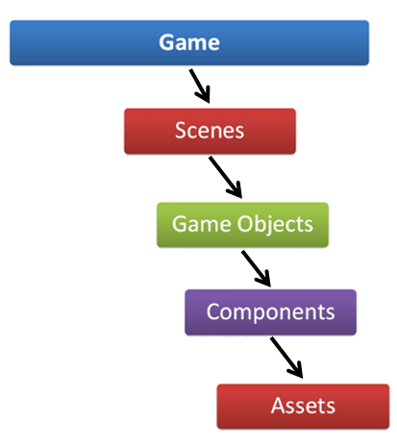
Risks Versus Game Decomposition
Games have many risks
Design Risk
Risk game will not be fun and people won’t like it
Implementation Risk
Possibility the development team will not be able to build the game
Market Risk
Game is great, but people don’t buy it
…
Later we will see how proper Game Decomposition can reduce the Implementation Risk

Slide 22
Also In the Future: Agile Design
Later
We will take a closer look at agile design
And how Rapid Prototyping relates

Slide 23
For Now: Take Away
The greater the Design Risk
the more unknowns you have
the more untested and unproven rules your have
The more iterations you will need

Slide 24
Risk to Video Games
Video games can have impressive technology
physics
graphics
sounds
…
Obscuring the “staleness” of the gameplay

Slide 25
Suggestion/Requirement
Take the time to create mockups
Do the iterations
Make the planning as solid as it can be
The catch
Must do so quickly enough to have time to implement

Slide 26
End Summary
Great designers do not design great games
Usually design really bad games
and then iterate on them until they become great
Notables
Have a playable mockup of your game as early in development as possible
Faster this happens = faster you can test ideas
With equal amounts of time to create
Shorter, simpler game will be better than long & complicated
Simple Reason: Longer games take longer to iterate

Slide 27
Questions?
Beyond D2L
Examples and information can be found online at:
http://docdingle.com/
Continue to more stuff as needed

Slide 28
References
Some material in these slides was derived/based on material from:
Ian Schreiber, Game Design Concepts
https://gamedesignconcepts.wordpress.com/
Released under a Creative Commons Attribution 3.0 U.S. License
http://creativecommons.org/licenses/by/3.0/us/

