Slide 1
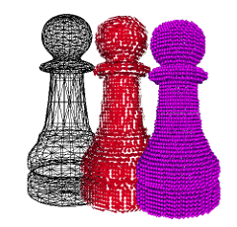
MDA Framework
A View of Game Parts for Analysis and Discussion
Brent M. Dingle, Ph.D. 2015
Game Design and Development Program
Mathematics, Statistics and Computer Science
University of Wisconsin - Stout
See also references at end of slides (if any)

Slide 2
Recall
Designing a game is designing a system
Game design and development is iterative
Games can be described as
the successive layering of constraints
Games have elements

Slide 3
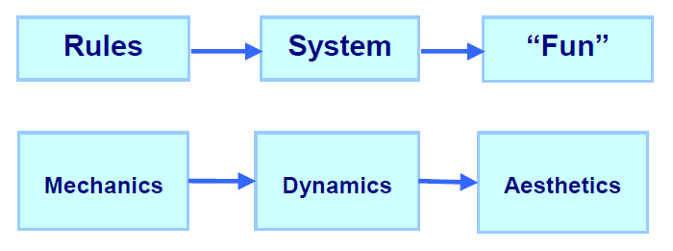
Another Set of Parts
It is possible to look at a game in different ways depending on how you define “parts”
The Mechanics, Dynamics, Aesthetics (MDA) Framework
Has received a lot of attention from industry professionals
Shows the designer perspective AND the player perspective
How each “sees” and relates to the same game parts
Aids the process of designing and developing a game
Defined in 2001 by LeBlanc, Hunicke, and Zabek
http://www.cs.northwestern.edu/~hunicke/MDA.pdf

Slide 4
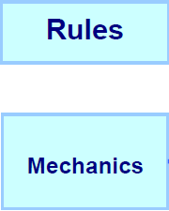
Mechanics = Rules
Mechanics are the rules of the game at the level of data representation and algorithms
These Formal Rules define
What is allowed (and not allowed)
How is the game setup
What actions can players perform
What goals/objectives can/should/must be achieved
When does the game end
Who wins, who loses, what is scored
How are rules enforced
…

Slide 5
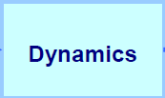
Dynamics = System (in motion)
Dynamics describe the run-time behavior of the mechanics acting on player inputs and each others’ outputs over time
Describe the “play” of the game
What strategies/behaviors emerge from the rules
How do the players interact with the environment and each other

Slide 6
Aesthetics = “Fun”
Aesthetics describes the desired emotional responses evoked in the player when interacting with the game system
Not the visual elements of the game
But rather the player experience of the game
enjoyable, fun, frustrating, boring, interesting…
emotionally or intellectually engaging

Slide 7
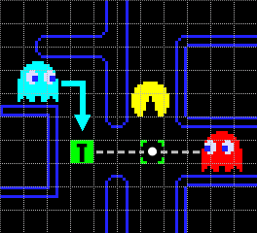
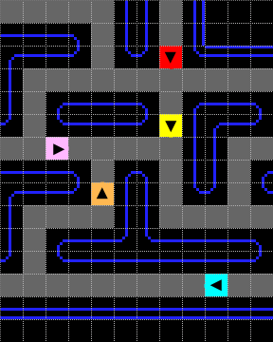
Example: Pac Man Mechanic
Ghost’s pathfinding logic is defined by rules
Each ghost has a unique seeking mechanic
Blinky targets the tile the player is in
Inky targets the end of the vector that
starts at Blinky,
goes through two tiles in front of player
is twice as long as distance of that tile to Blinky
http://home.comcast.net/~jpittman2/pacman/pacmandossier.html

Slide 8
Example: Pac Man Dynamic
The rules create a dynamic
where the player is trapped by Blinky and Inky
http://home.comcast.net/~jpittman2/pacman/pacmandossier.html

Slide 9
Example: Pac Man Dynamic
The enemy dynamics challenge the player
creating an aesthetic of fun and excitement
http://home.comcast.net/~jpittman2/pacman/pacmandossier.html

Slide 10
Example: Spawn Points
First-Person Shooters often have a “Spawn Point” Mechanic

Slide 11
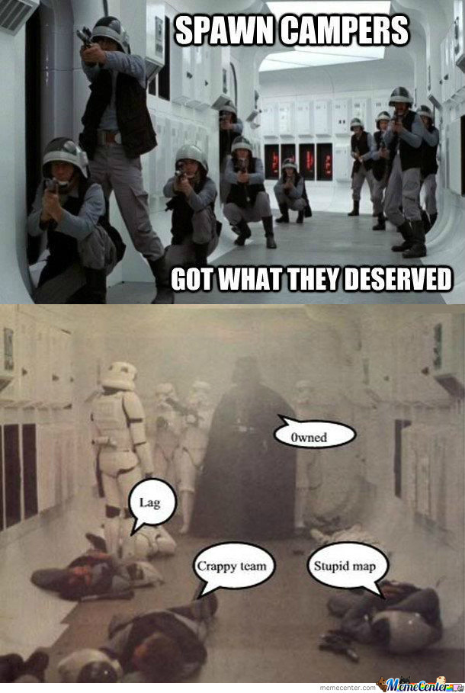
Example: Spawn Points
Leading to the dynamic where a player may sit near a spawn point and take out players as they respawn

Slide 12
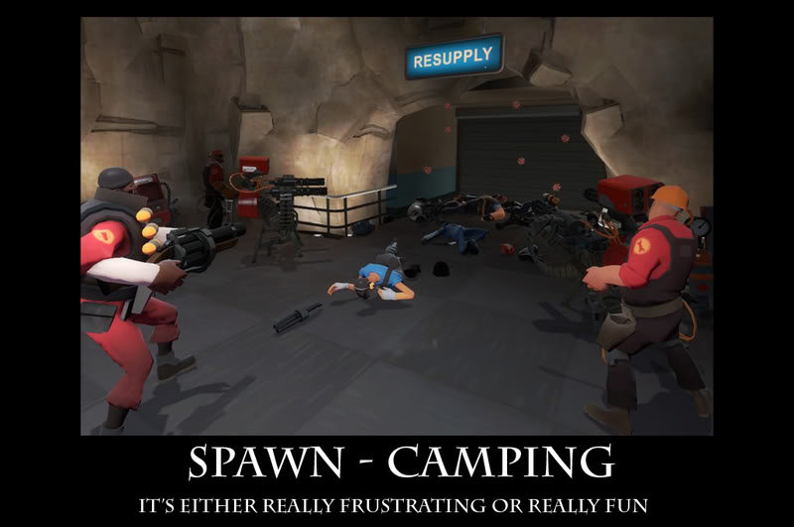
Example: Spawn Points
Leading to the Aesthetic of Player Frustration

Slide 13
Order of Thought
This is the order a Designer will often experience/plan the game
Designers control the mechanics
Mechanics generate dynamics
Dynamics generate aesthetics
Designers often work outward
design the mechanic to generate the desired aesthetic

Slide 14
Player View
Players see things in reverse order
Aesthetics set the tone
which is created from observed dynamics
which is controlled by operable mechanics

Slide 15
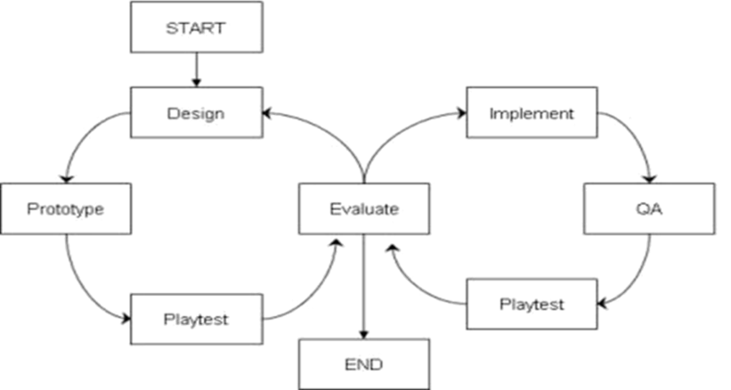
End Summary
Games are composed of elements/parts
Rules are a major part of a game
Designers create rules
Rules create gameplay
Gameplay creates player experience
A small rule change may have enormous (or no) effect
Play Testing is critical
Test early ➔ mockups, prototypes
Test Often
Evaluate
Improve
Iterate, Iterate, Iterate
From “Success” to “More Success”

Slide 16
Questions?
Beyond D2L
Examples and information can be found online at:
http://docdingle.com/teaching/gdd450/
Continue to more stuff as needed

Slide 17
References
Some material in these slides was derived/based on material from:
Ian Schreiber, Game Design Concepts
https://gamedesignconcepts.wordpress.com/
Released under a Creative Commons Attribution 3.0 U.S. License
http://creativecommons.org/licenses/by/3.0/us/
Matthew Gallant, Mechanics, Dynamics & Aesthetics
Blog, August 21, 2009
http://gangles.ca/2009/08/21/mda/

